Slide 1


TEAM 2: MARIANO SOARES, JULIA COLLINGWOOD, JOSHUA FOUCH

Slide 2
Table of contents

Slide 3
Table of contents
1
Project Breakdown

Slide 4
Table of contents
1
Project Breakdown
2
Client User Story

Slide 5
Table of contents
1
Project Breakdown
2
Client User Story
3
Sitemaps and Wireframes

Slide 6
Table of contents
1
Project Breakdown
2
Client User Story
3
Sitemaps and Wireframes
4
Basic Styling

Slide 7
Table of contents
1
Project Breakdown
2
Client User Story
3
Sitemaps and Wireframes
4
Basic Styling
5
Details

Slide 8
Table of contents
1
Project Breakdown
2
Client User Story
3
Sitemaps and Wireframes
4
Basic Styling
5
Details
6
Demo

Slide 9
Table of contents
1
Project Breakdown
2
Client User Story
3
Sitemaps and Wireframes
4
Basic Styling
5
Details
6
Demo
7
What’s next?

Slide 10
Project Breakdown
Project Mode: Personal Blog
Tasks 1-4 Completed
Live Demo of functional Home & Recipe pages

Slide 11
Client User Story
GOAL
Reagan S., CollegeLife Recipes
AUDIENCE
AESTHETIC

Slide 12
CollegeLife
Recipes - User Story

Slide 13
CollegeLife
Recipes - User Story
A former student who wants to share his recipes online

Slide 14
CollegeLife
Recipes - User Story
A former student who wants to share easy recipes online
This website’s target audience is college students who don’t have time for cooking and miss Mom’s cooking.

Slide 15
CollegeLife
Recipes - User Story
A former student who wants to share easy recipes online
Target audience: college students with busy schedules & miss Mom’s cooking.
Recipes are easy and quick
Website is designed to save you time (minimalistic)

Slide 16
Task 1: Building the Website
Sitemaps and Wireframes
DEFINED WEBSITE FEATURES
CREATED SITEMAPS
DEVELOPED WIREFRAMES FOR EACH PAGE REQUIRED
CREATED TASK TIMELINE (GITHUB BACKLOG)

Slide 17
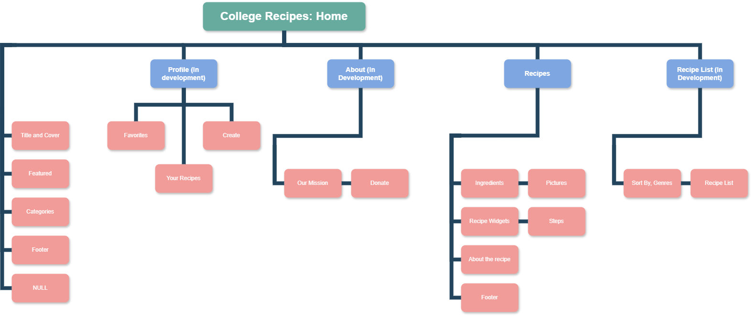
Sitemap

Slide 18
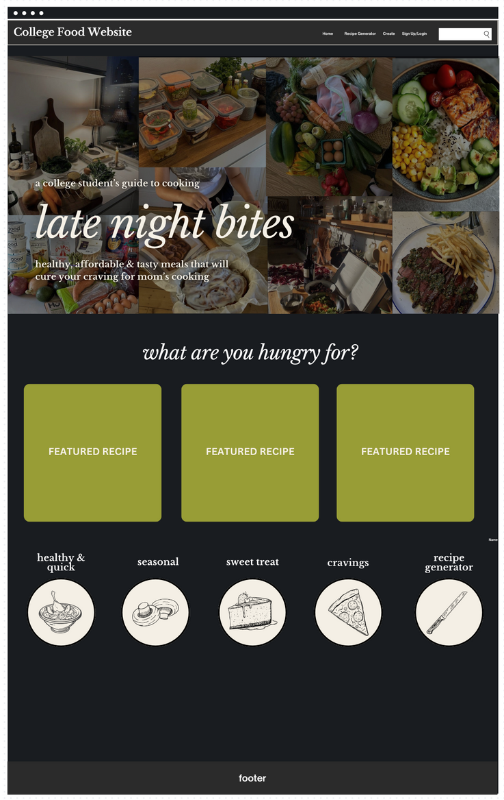
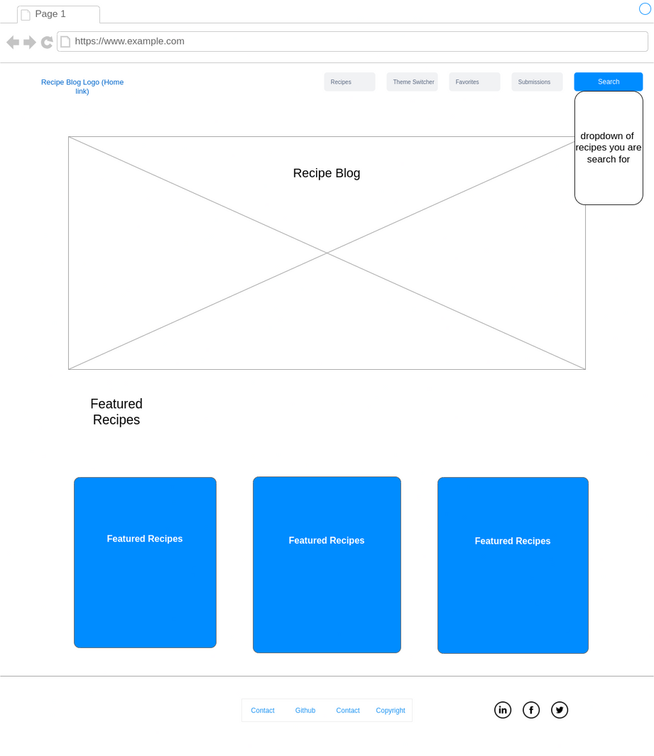
Home Page Wireframe

Slide 19
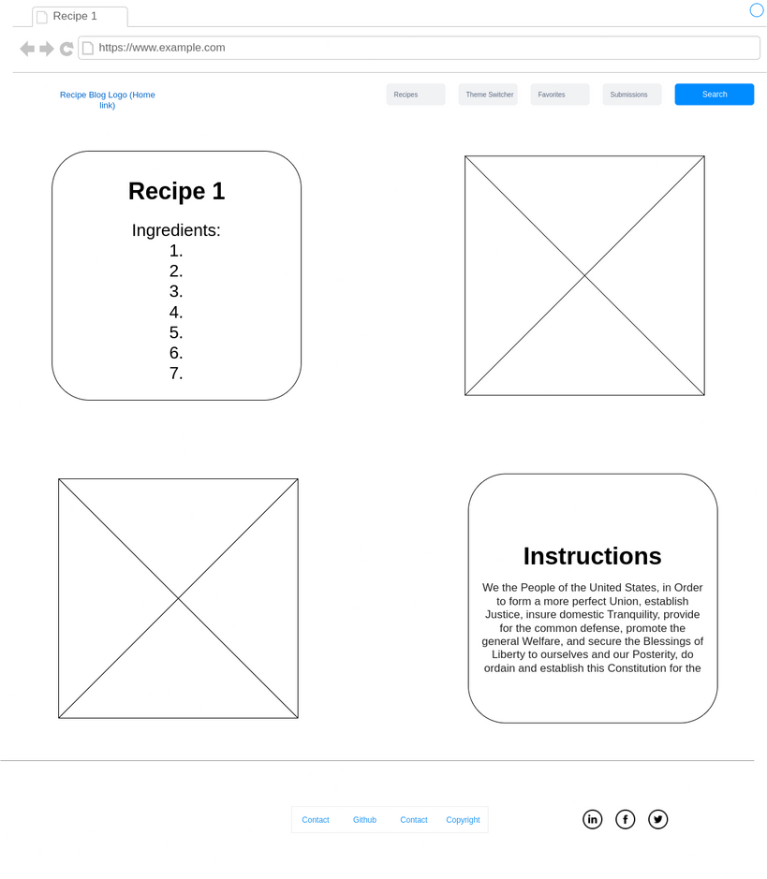
Recipe Page Wireframe

Slide 20
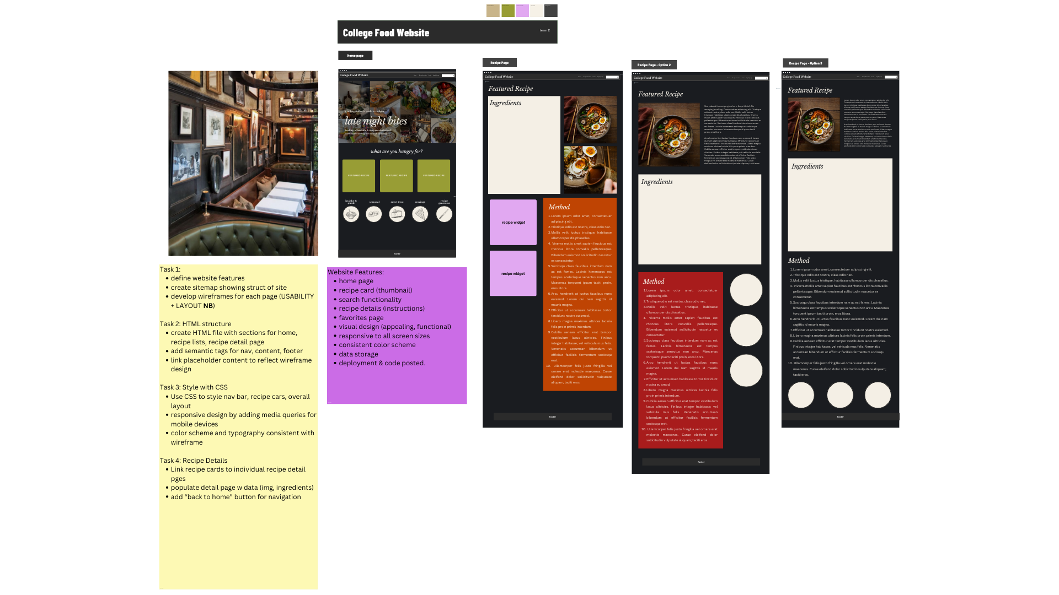
recipe page

Slide 22
Task 2: Setting up the basic HTML
CREATED HTML FILE WITH HOMEPAGE, RECIPE LISTINGS, RECIPE DETAIL PAGE
ADDED SEMANTIC TAGS FOR NAVIGATION
LINKED SOME PLACEHOLDER CONTENT TO REFLECT THE WIREFRAME DESIGN

Slide 23
basic styling
matching the user story’s aesthetics
TARGET AUDIENCE: YOUNG COLLEGE-AGE ADULTS
STYLE: MINIMALIST, SLEEK
FONT DESIGN: HANDWRITING, NEAT (PERSONAL & ECHOES ‘STUDENT NOTE-TAKING’)
COLOR INSPIRATION: MOODY ENGLISH PUB, LATE NIGHT LED DORM ROOM
DESIGN MUST BE CRISPY WITH HIGH CONTRAST

Slide 24

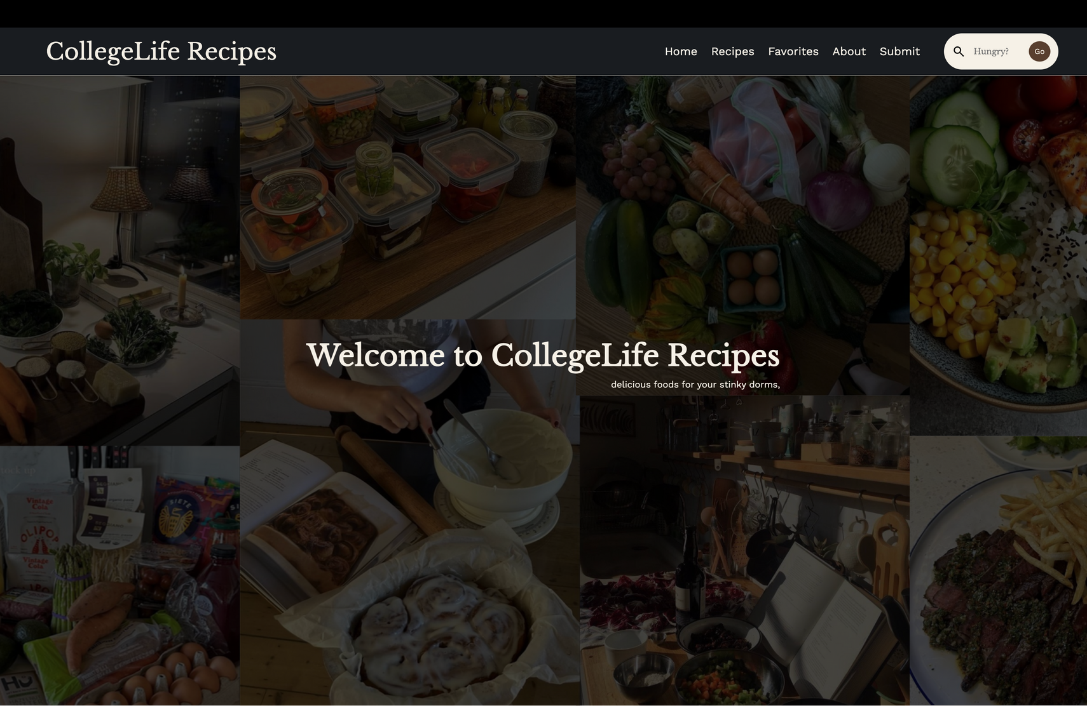

Slide 25
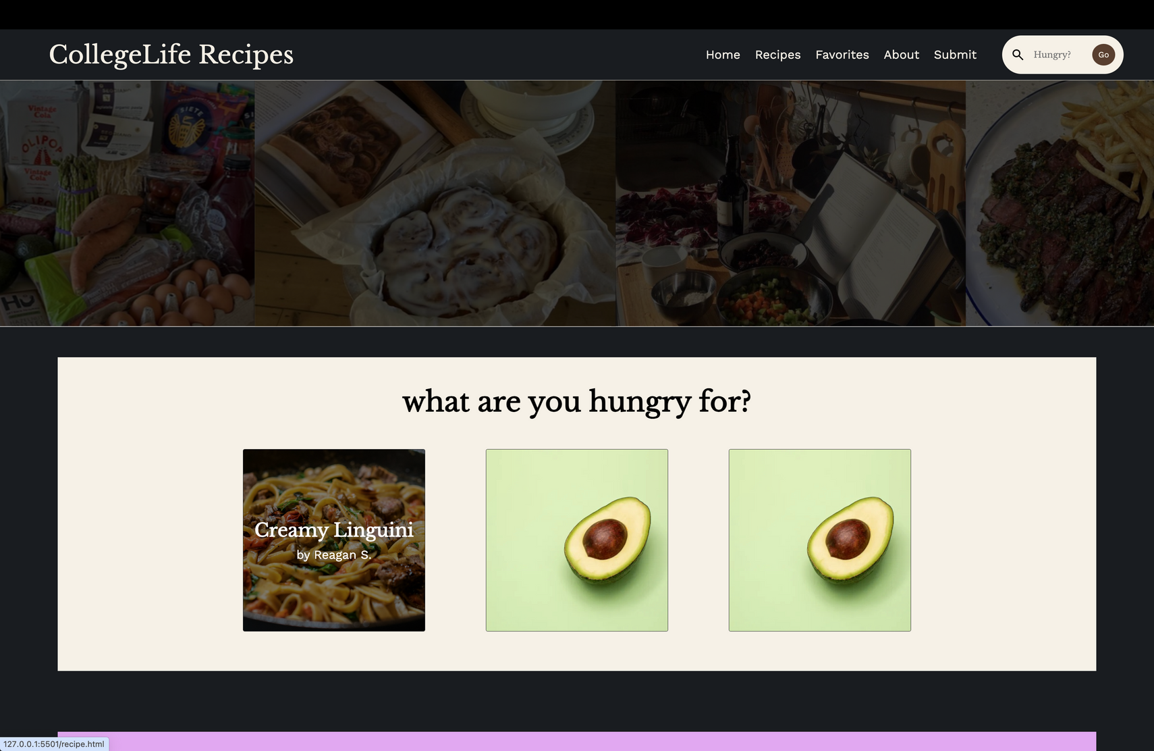

Slide 26
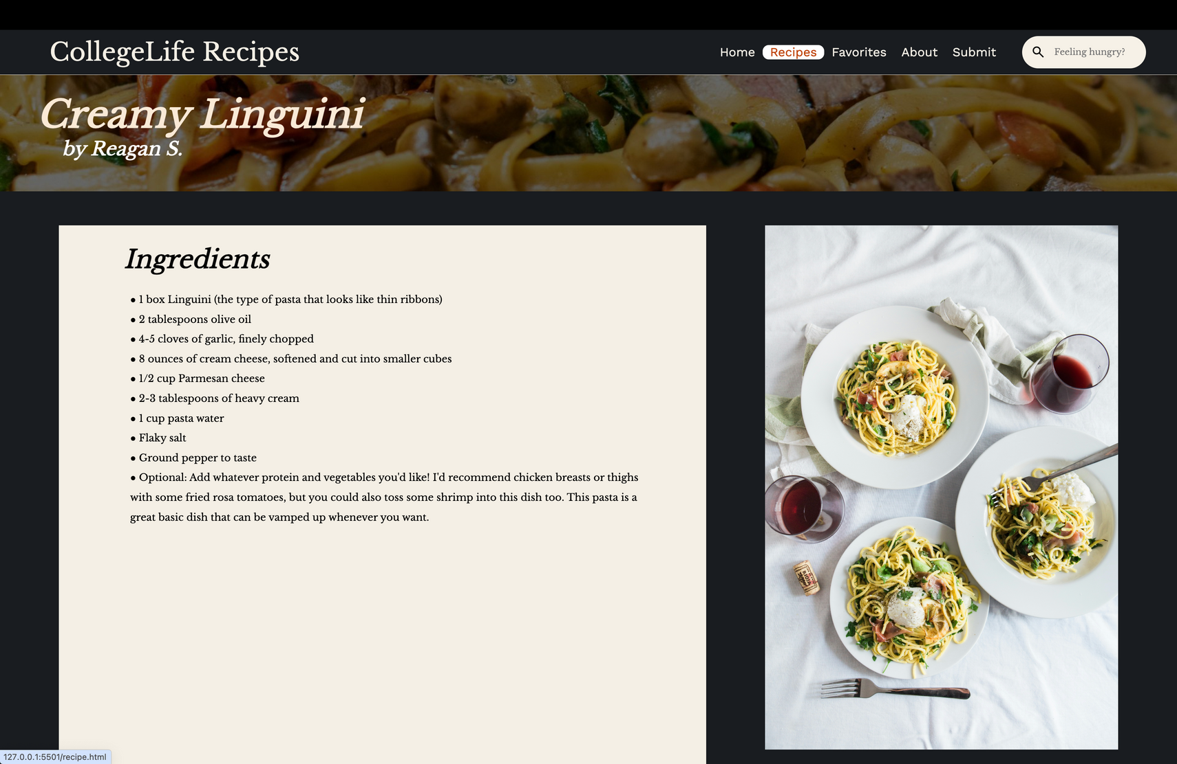

Slide 27
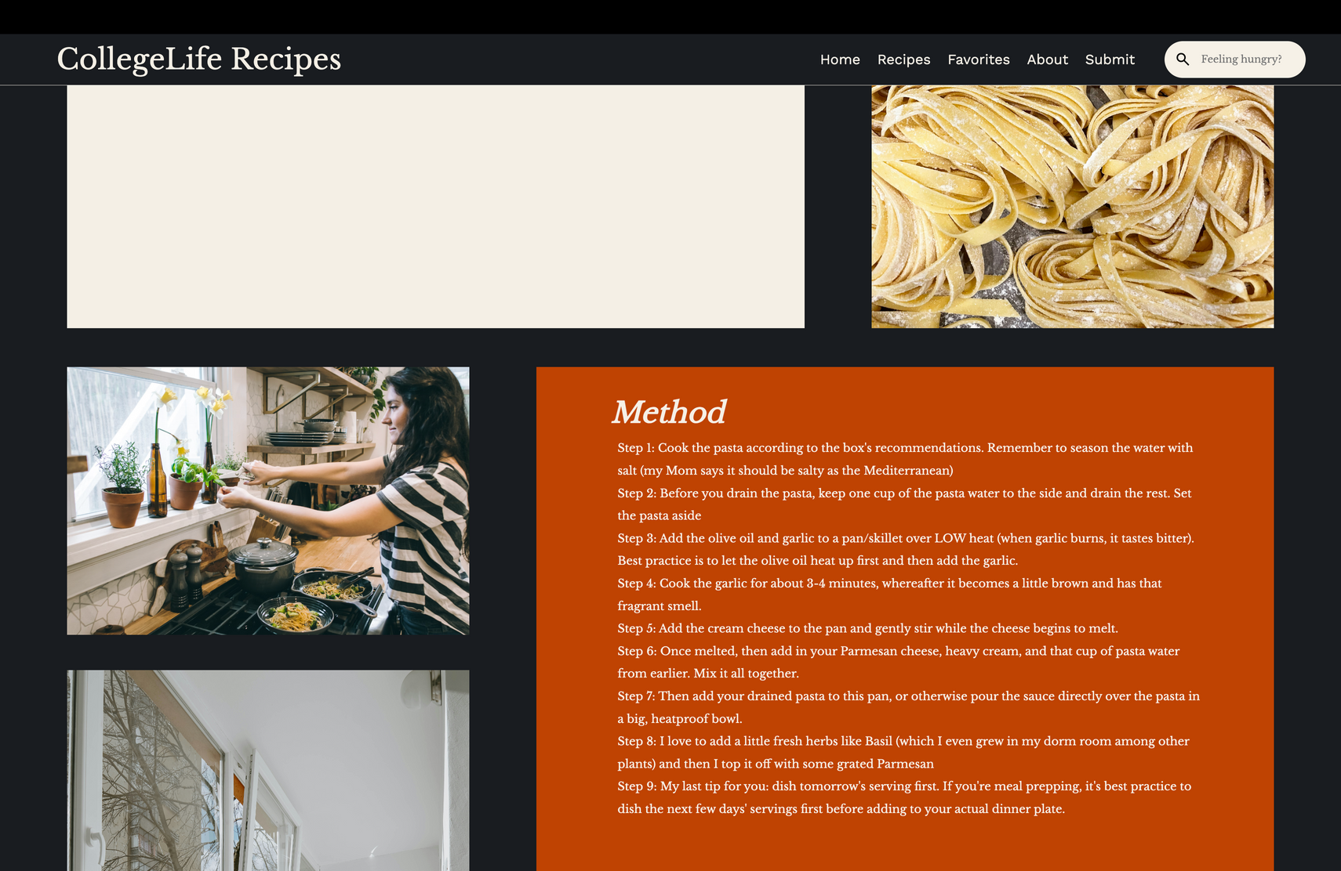

Slide 28
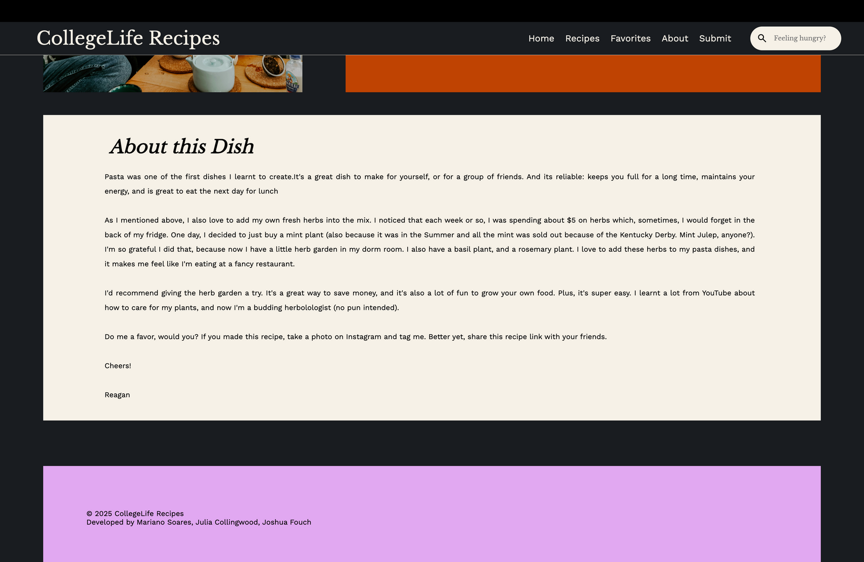

Slide 29
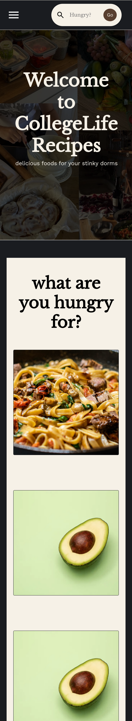
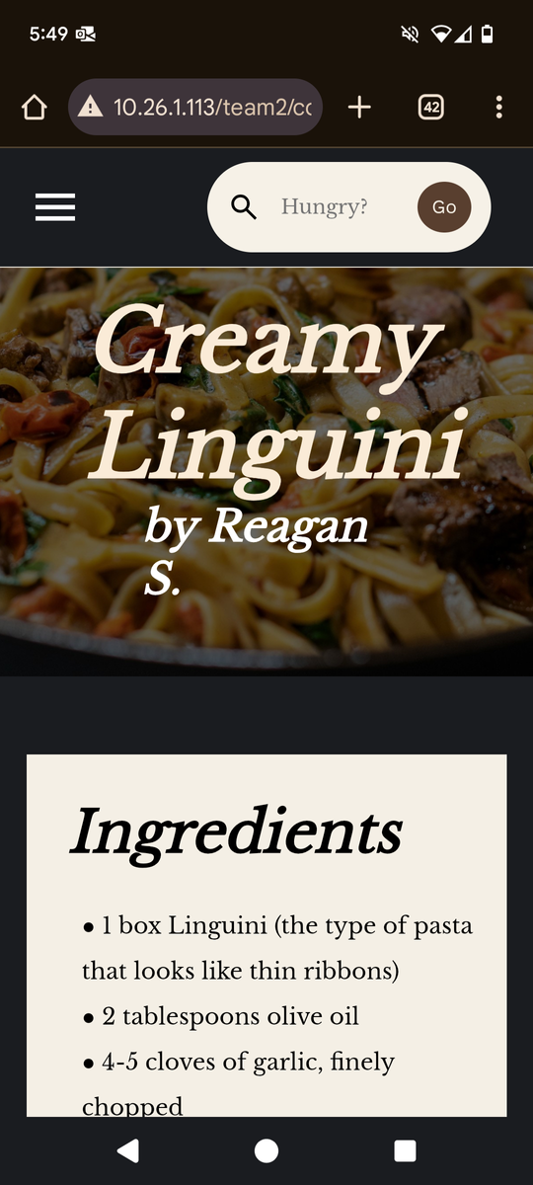

Mobile Query
Try it yourself
MUST BE CONNECTED TO BARONNET

Slide 30
Overall style
MOODY
YOUTHFUL
SLEEK
MINIMALIST

Slide 31
Website and Demo
How CollegeLife Recipes currently looks
What’s working?
What needs adjustment?
Adapt and refine based on feedback and results

Slide 32
What’s next?
ADDING JSON FILES’ CONTENT
IMPLEMENTATION OF ADDITIONAL FEATURES
IMPLEMENTING JAVASCRIPT TO FETCH CONTENT IN HTML PAGE
MORE CSS STYLING

Slide 33
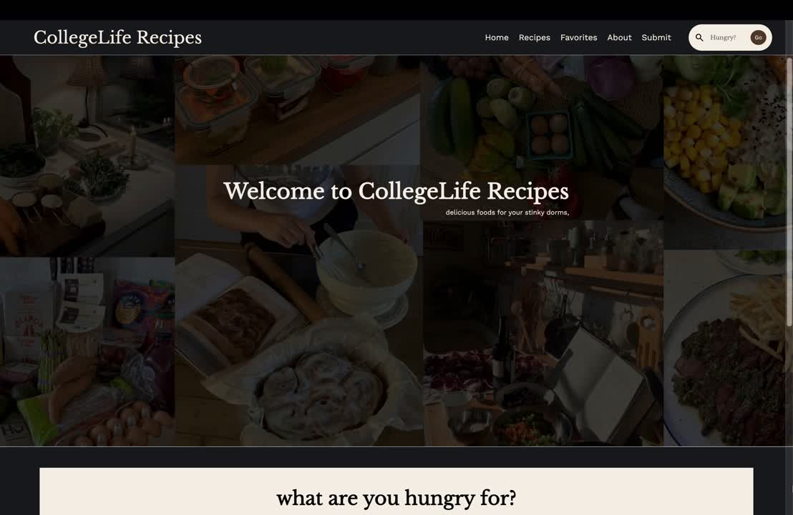

Slide 34
Thank you

